Slide 1



Collaborative
Farming
Tushar Amol Gaikwad

Slide 2



Contents
03/
Objective
04/
Benefits of Platform
01/
Introduction
04/
Proposed
Solution
02/
Problem Statement

Slide 3

Introduction
The Collaborative Farming project is a web-based platform designed to bridge the gap between non-professional farmers, farmers, and agricultural service providers. It aims to optimize land utilization by enabling land leasing and rentals while also providing easy access to agricultural services and government schemes. By leveraging technology, the platform enhances collaboration, reduces operational challenges, and promotes sustainable farming practices.
Unlike traditional agricultural platforms, this system does not include crop selling, a marketplace, or community features. Instead, it focuses solely on connecting stakeholders for land utilization and service access, ensuring transparency and efficiency in the farming ecosystem.

Slide 4
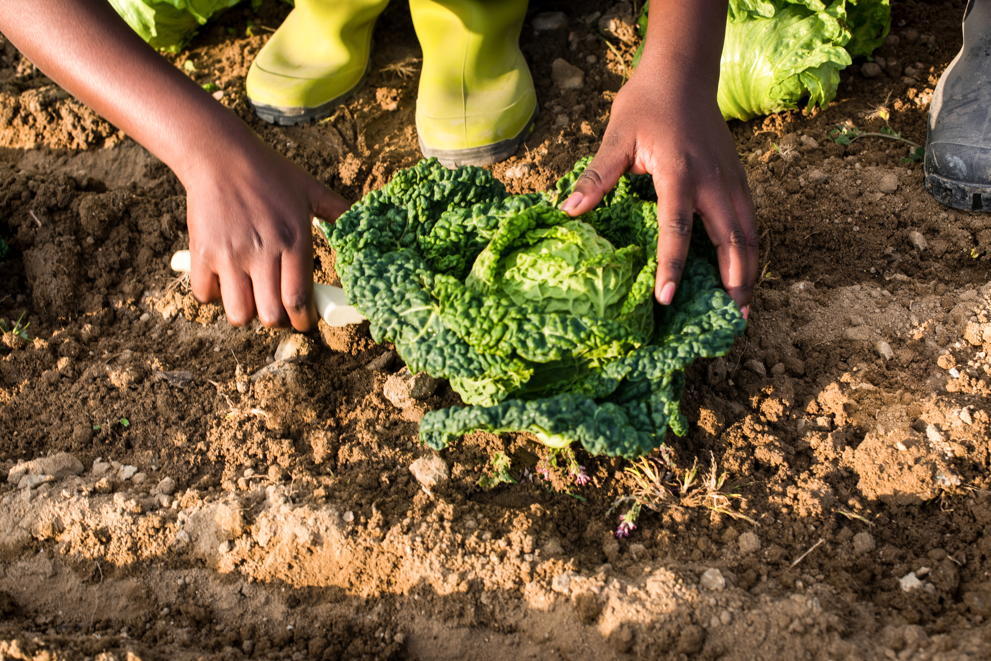
Problem Statement
1. Underutilization of Agricultural Land –
2. Limited Access to Agricultural Services –
3. Lack of Awareness About Government Schemes –
4. Fragmented Collaboration in Agriculture –
5. Complex Land Leasing Process –

Slide 5
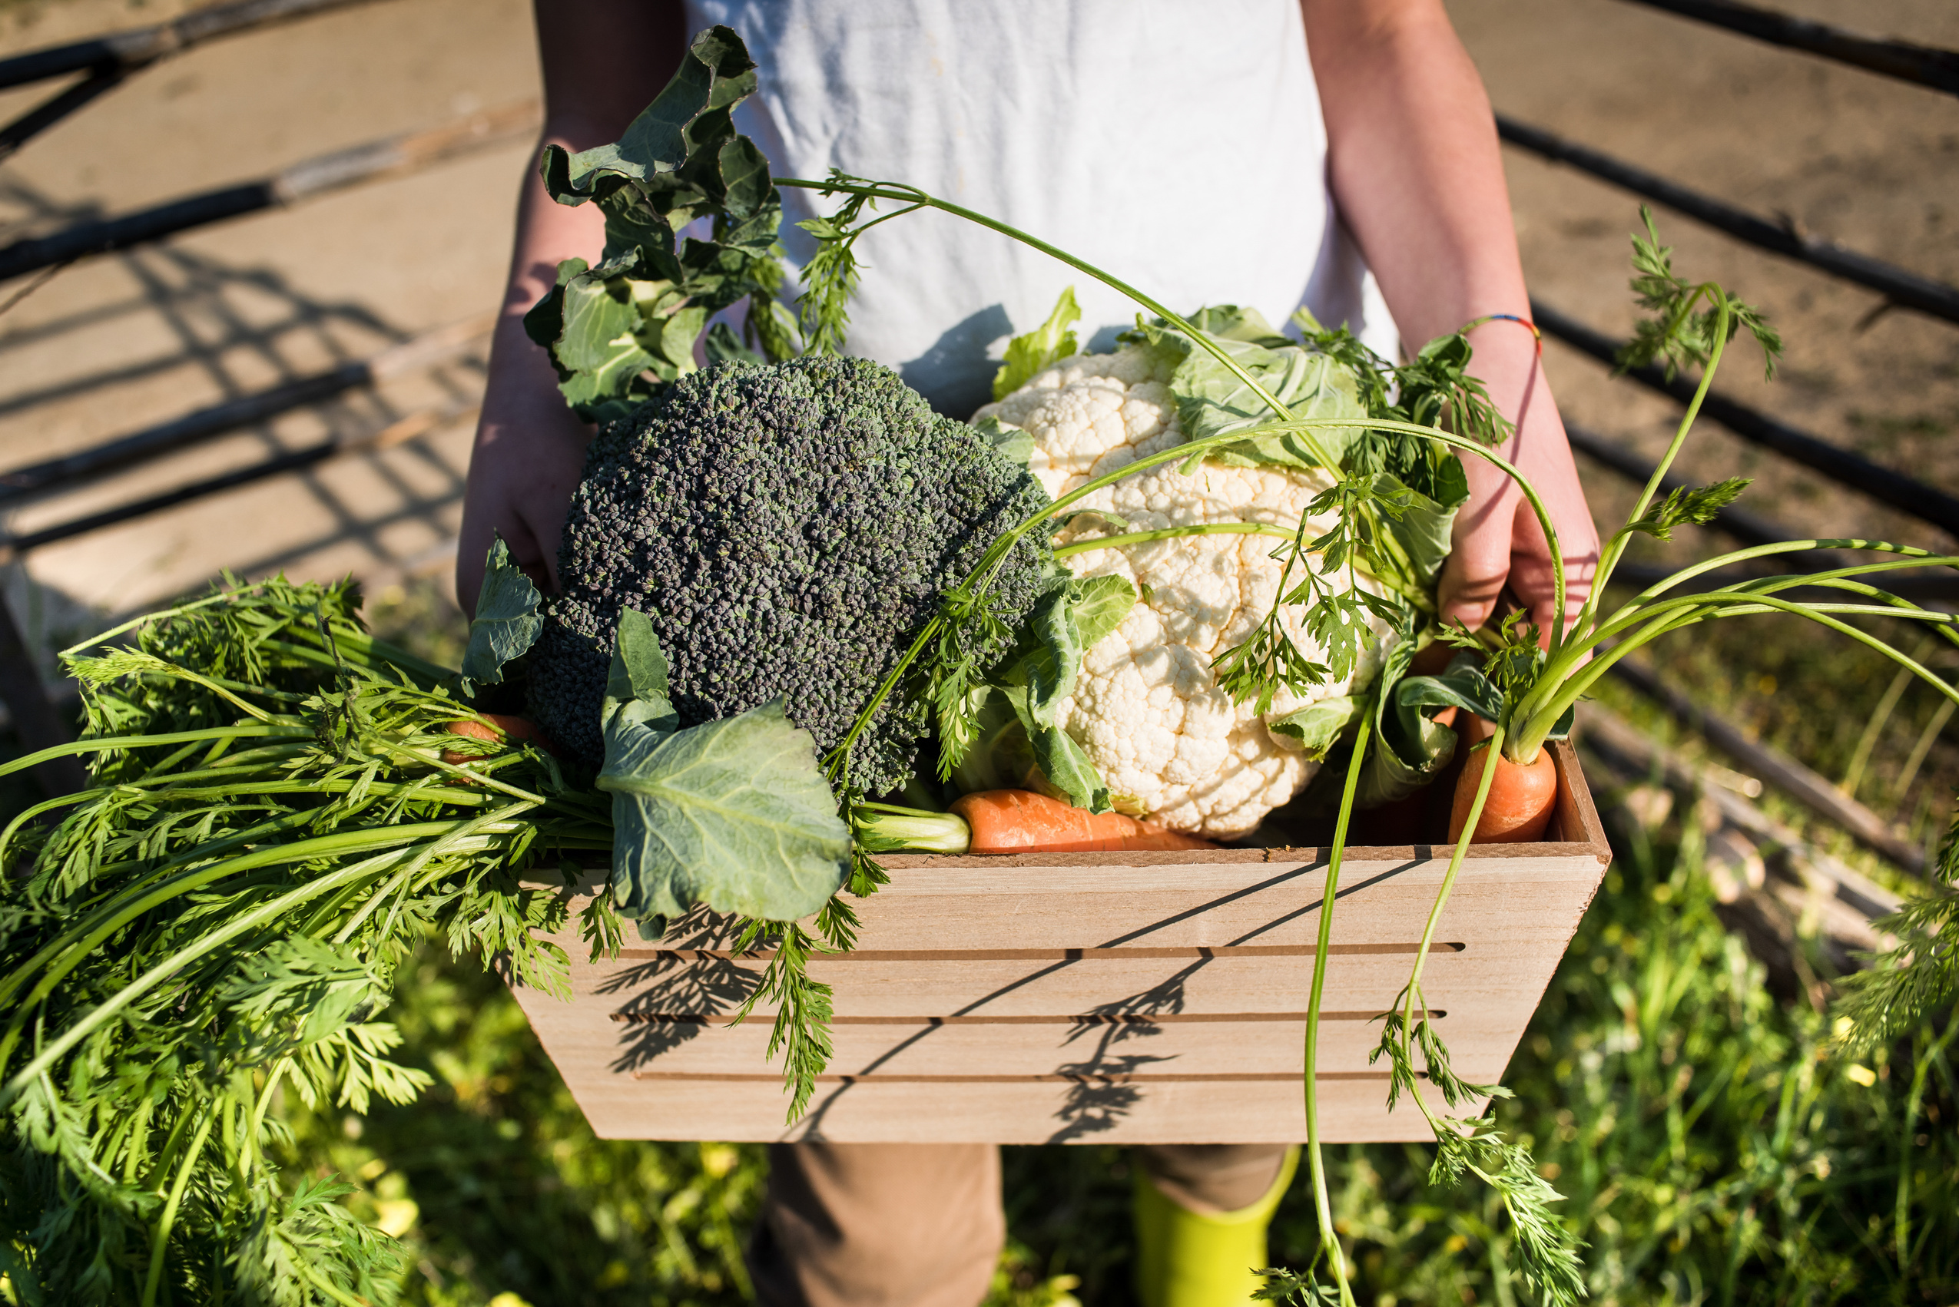
Objective
Optimize Land Utilization
Enhance Access to Agricultural Services
Enable Secure and Transparent Transactions
Increase Awareness of Government Schemes
Promote Collaboration in Agriculture
Ensure Data Management & Accountability

Slide 6
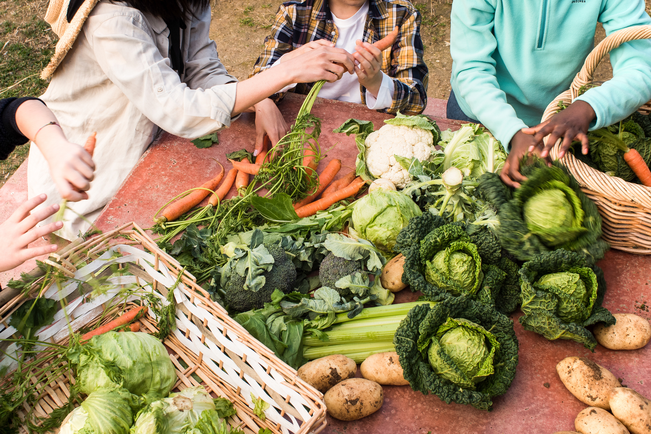
Proposed Solution
1 Web-Based Platform
2 Land Leasing & Rental System
3 Agricultural Services Marketplace
4 Government Scheme Information Center
5 Secure Payments & Digital Agreements
6 Data Management & Transparency

Slide 7
Benefits of the Platform
1. Benifits for Different Stakeholders
For Professional Farmers:
Easily lease or rent agricultural land for farming.
Access various farming-related services to enhance productivity.
Gain insights into government schemes for financial and technical support.
For Non-Professional Farmers:
Find opportunities to lease or rent their land to professional farmers or companies.
Utilize agricultural services for better farm management.
Get real-time updates on government schemes and subsidies.
For Service Providers:
Offer agricultural services such as equipment rental, soil testing, and consultancy.
Expand their reach to farmers and agricultural businesses.
Manage service requests and payments efficiently.

Slide 8
Unique Selling Proposition (USP)
Why Choose Our Platform?
1. Empowering Landowners (Non-Professional Farmers)
Enables landowners to lease their land efficiently and generate income without direct involvement in farming.
2. Seamless Land Leasing for Farmers
Farmers can easily find and lease agricultural land suited to their needs.
3. Comprehensive Agricultural Services
Access to a wide range of services, from soil testing to machinery rentals, ensuring productive farming.
5. Government Schemes Integration
Provides information on relevant government schemes and subsidies for farmers.

Slide 9
Revenue Model
Lease Commission Model
Charge a small commission on each successful land lease agreement between landowners and farmers.
Service Subscription & Commission
Partner with agricultural service providers and take a commission for every service booked via the platform.
Freemium Model for Users
Basic features for free, while premium users get advanced insights, priority listings, and better support.
Advertisement & Sponsorships
Allow agricultural businesses, seed providers, and equipment manufacturers to advertise on the platform.
Government & NGO Partnerships
Collaborate with government bodies and NGOs supporting agricultural initiatives for funding or grants.

Slide 10
Target Audience
Landowners (Non-Professional Farmers)
Individuals who own land but lack farming expertise and wish to lease it for agricultural purposes.
Farmers (Looking for Land)
Professional or aspiring farmers in need of arable land on lease to cultivate crops.
Agricultural Service Providers
Businesses offering soil testing, irrigation solutions, farm equipment rentals, and other farming-related services.
Government Agencies & NGOs
Organizations working to improve agricultural efficiency and sustainability.
Investors & Agri-Tech Startups
Entities looking to support or partner with tech-driven solutions in farming and land management.

Slide 11
Thanks
Tushar Amol Gaikwad

Slide 12
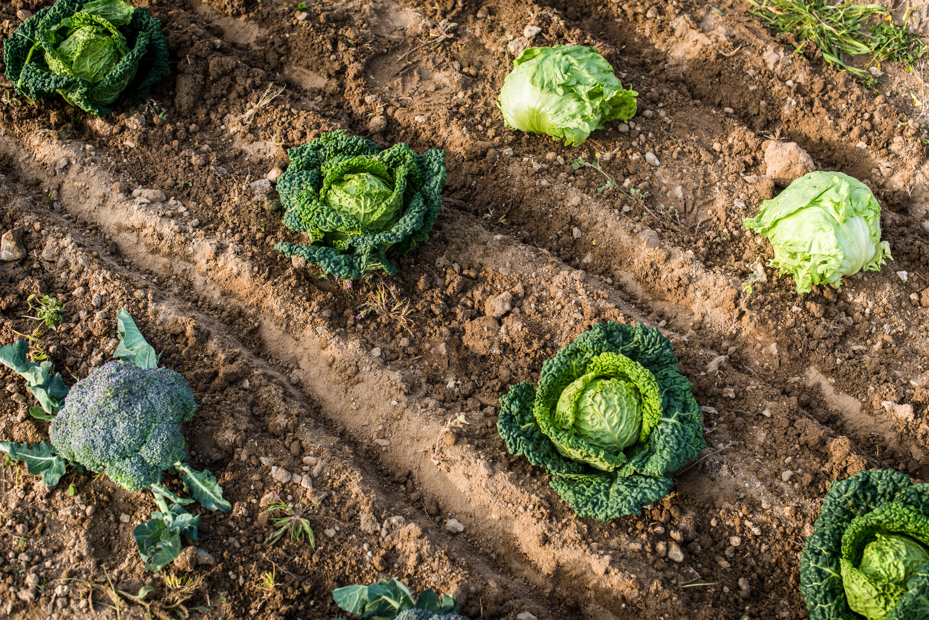
How the Platform Works
This section explains the workflow and database structure of the Collaborative Farming Platform, focusing on user roles, leasing process, service booking, and database schema.

Slide 13
1. User Roles & Access
The platform has three primary user roles, each with specific access:
1 Landowner
Can list their land for lease or rent land from others.
Can book agricultural services like equipment rental, soil testing, etc.
Can access government scheme information.
2 Farmers
Can search for available land and lease it for farming operations.
Can hire service providers for farm management tasks.
Can enter digital agreements with farmers.
3 Service Providers
Can list agricultural services (e.g., soil testing, irrigation setup, equipment rental).
Can receive service requests from farmers and companies.
Can receive payments through the platform.

Slide 14
Workflow of Land Leasing & Renting
1 Landowner (Farmer) Lists Land
Farmer uploads land details (location, size, lease terms).
2 Farmers
Companies browse land listings and select a suitable option.
3 Agreement & Payment Process
Both parties agree on leasing terms and sign a digital contract.
Payment is made through a secure transaction system.
4 Lease Activation & Land Utilization
Farmers gains access to the land for the lease duration.
Lease Completion
Upon lease expiry, both parties can renew the contract or terminate it.

Slide 15
3. Service Booking & Payments Flow
1 Service Provider Lists Available Services
Equipment rental, irrigation setup, soil testing, etc.
2 Farmers Browse & Book Services
Users select services based on availability, pricing, and ratings.
3 Booking Confirmation & Payment
Payment is processed securely through the platform.
4 Service Execution & Completion
The service provider delivers the service as per booking details.
5 Feedback & Review System
Users can rate and review service providers for future users.

Slide 16
Database Schema Overview (ColabDB)
1 User Table (Stores all types of users)
Stores details of farmers, companies, service providers, and admins.
Primary Key: id
Key Fields: name, contact, email, type_of_user (enum: 'admin', 'farmer’, Landowner’, ‘service_provider’).
2 Property Table (Stores farmer's land details)
Tracks land listings, including location, area, and images.
Primary Key: property_id
Foreign Key: farmer_id → User(id)
Key Fields: type_of_land, land_image, document_image, area_acre, area_guntha.

Slide 17
Service Provider Table (Stores details of service providers)
Links service providers to the services they offer.
Primary Key: id
Foreign Keys: service_id → Services(service_id), user_id → User(id)
Key Fields: price, area (per acre), description.
Agreement Table (Tracks agreements for land leases & services)
Records agreements between users, properties, and services.
Primary Key: agreement_id
Foreign Keys: user_id → User(id), service_id → Service(service_id), property_id → Property(property_id)
Key Fields: status (enum: 'accepted', 'pending', 'rejected', 'completed'), start_date, end_date, time_duration.

Slide 18
5 Payment Table (Manages transactions)
Stores payment records for services and land leases.
Primary Key: payment_id
Foreign Key: agreement_id → Agreement(agreement_id)
Key Fields: total_amount, payment_method (enum: 'UPI', 'Credit Card', 'Debit Card', 'Net Banking'), payment_status (enum: 'Paid', 'Pending', 'Failed’).
6 Government Schemes Table (Stores farming-related schemes added by admin)
Lists available government schemes for farmers.
Primary Key: scheme_id
Key Fields: title, price, start_date, last_date, description.

Slide 19
7 Government Scheme Applications Table (Tracks farmer applications for schemes)
Farmers can apply for schemes added by the admin.
Primary Key: application_id
Foreign Keys: scheme_id → Government Schemes(scheme_id), farmer_id → User(id)
Key Fields: register_date, status (enum: 'Pending', 'Accepted', 'Rejected’).
8 Services Table (Stores all services offered on the platform)
Lists all agricultural services available for booking.
Primary Key: service_id
Key Field: service_name.

Slide 20

Technologies
Language: Java.
Frontend: React / Angular
Database: Postgresql
Softwares : VS Code, Postman

